Slide 1
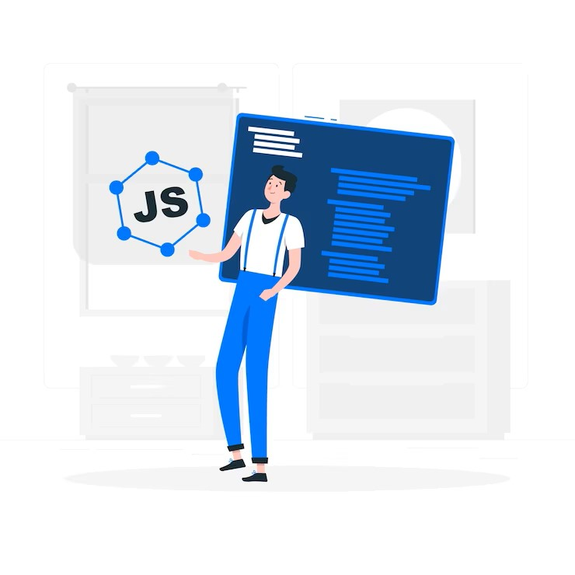

JAVASCRIPT Chapter 1
JAVASCRIPT BASICS

Slide 2
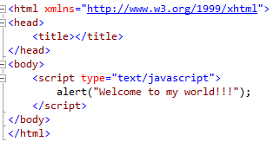
JavaScript Syntax
JavaScript consists of JavaScript statements that are placed within the <script>…</script>
<script> type="text/javascript"> and </script> tell where JavaScript starts and ends.

Slide 3

JavaScript Syntax
Certain characters and terms are reserved.
JavaScript is case-sensitive.
Each code statement has to end with a semicolon (;).
JavaScript ignores spaces, tabs, and newlines that appear in JavaScript programs
JavaScript is simple text (ASCII).

Slide 4

Where to put your scripts?
Place scripts in any of the following locations:
Between the HTML document's head tags.
Within the HTML document's body (i.e. between the body tags).
In an external file (and link to it from your HTML document).

Slide 5
Comments in JavaScript
Single Line Comments:
Any text between a // and the end of a line is treated as a comment
Any Text between a<!– closing sequence //-->
Multiple Line Comments:
Any text between the characters /* and */ is treated as a comment. This may span multiple lines.

Slide 6
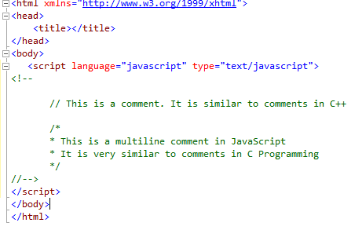
Comments in JavaScript

Slide 7


JavaScript Data Types
All numbers in JavaScript are represented as floating-point values.
JavaScript does not make a distinction between integer values and floating-point values.

Slide 8

JavaScript Variables
Variables can be thought of as named containers.
Place data into these containers and then refer to the data simply by naming the container.
Before using a variable in a JavaScript program, must declare it.
Variables are declared with the var keyword

Slide 9
JavaScript Variables
JavaScript is an untyped language.
This means that a JavaScript variable can hold a value of any data type.
Unlike many other languages, don't have to tell JavaScript during variable declaration what type of value the variable will hold.
The value type of a variable can change during the execution of a program and JavaScript takes care of it automatically.

Slide 10
JavaScript Variable Scope
JavaScript variable will have only two scopes:
1) Global Variables:
A global variable has global scope which means it is defined everywhere in your JavaScript code.
2) Local Variables:
A local variable will be visible only within a function where it is defined. Function parameters are always local to that function.

Slide 11
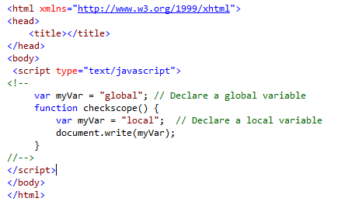
JavaScript Variable Scope

Slide 12
JavaScript Variable Names
Should not use any of the JavaScript-reserved keywords as variable names.
JavaScript variable names should not start with a numeral (0-9).
Must begin with a letter or the underscore character

Slide 13
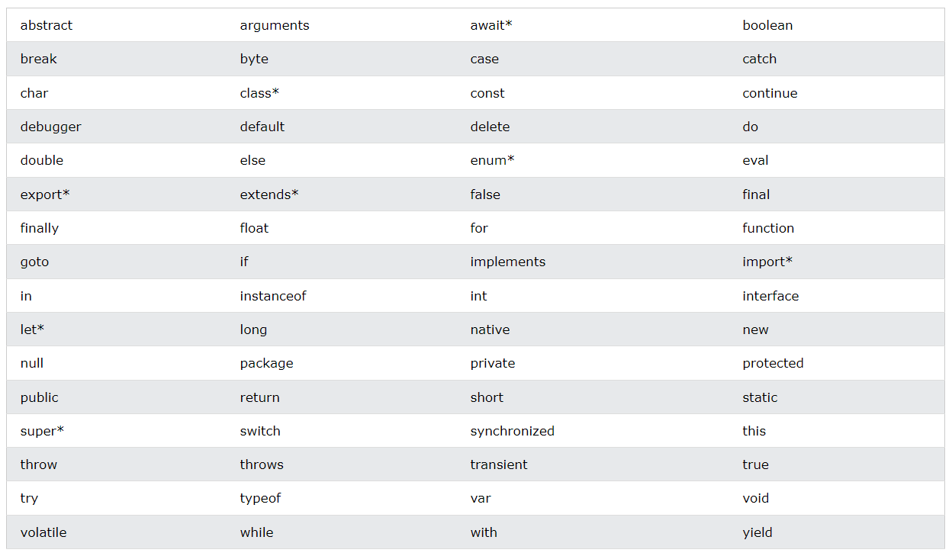
JavaScript Reserved Names

Slide 14
JavaScript Operators
JavaScript language supports the following type of operators:
Logical (or Relational) Operators: (&&,||,!)
Comparison Operators: (==,!=,<=,>=,<,>)
Arithmetic Operators:
(+,-,/,*,%,++,--)
Conditional (or ternary) Operators: (?: )
Assignment Operators: (=,+=,-=,*=,/=)

Slide 15
Conditional Statements
JavaScript supports conditional statements which are used to perform different actions based on different conditions.
JavaScript supports the following forms of if-else statements:
Use if to specify a block of code to be executed, if a specified condition is true
Use else to specify a block of code to be executed, if the same condition is false
Use else if to specify a new condition to test, if the first condition is false
Use switch to specify many alternative blocks of code to be executed

Slide 16
If Statement
Use the if statement to specify a block of JavaScript code to be executed if a condition is true.
if (condition)
{ // block of code to be executed if the condition is true }
if (hour < 18)
{ greeting = "Good day"; }

Slide 17
Else Statement
Use the else statement to specify a block of code to be executed if the condition is false.
if (condition)
{ // block of code to be executed if the condition is true }
else
{ // block of code to be executed if the condition is false }
if (hour < 18)
{ greeting = "Good day"; }
else
{ greeting = "Good evening"; }

Slide 18
else if statement
Use the else if statement to specify a new condition if the first condition is false.
if (condition1) { // block of code to be executed if condition1 is true }
else if (condition2) { // block of code to be executed if the condition1 is false and condition2 is true }
else { // block of code to be executed if the condition1 is false and condition2 is false }
if (time < 10)
{ greeting = "Good morning"; }
else if (time < 20)
{ greeting = "Good day"; }
else
{ greeting = "Good evening"; }

Slide 19
Switch Statement
Use the switch statement to select one of many code blocks to be executed.
switch(expression)
{ case x: // code block break; case y: // code block break; default: // code block }
let a = 2;
switch (a) {
case 1:
a = 'one';
break;
case 2:
a = 'two';
break;
default:
a = 'not found’;
break;
}
console.log(`The value is ${a}`);

Slide 20
JavaScript Events
JavaScript's interaction with HTML is handled through events
Events are actions.
A few examples of events:
A mouse click
The webpage loading
Mousing over a hot spot on the webpage, also known as hovering
Selecting an input box in an HTML form
A keystroke

Slide 21
Standard Events
Event | Description
onchange | Script runs when the element changes
onsubmit | Script runs when the form is submitted
onreset | Script runs when the form is reset
onselect | Script runs when the element is selected
onfocus | Script runs when the element gets focus
onkeydown | Script runs when key is pressed
onkeypress | Script runs when key is pressed and released

Slide 22
Standard Events
Event | Description
onmousedown | Script runs when mouse button is pressed
onmousemove | Script runs when mouse pointer moves
onmouseout | Script runs when mouse pointer moves out of an element
onmouseover | Script runs when mouse pointer moves over an element
onmouseup | Script runs when mouse button is released
onkeyup | Script runs when key is released
onclick | Script runs when a mouse click
ondblclick | Script runs when a mouse double-click

Slide 23
JavaScript Functions
A function is a group of reusable code which can be called anywhere in the program.
Divide a big program into a number of small and manageable functions.
Before using a function we need to define that function.
Define a function in JavaScript by using the function keyword

Slide 24
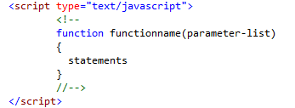
JavaScript Functions

Slide 25

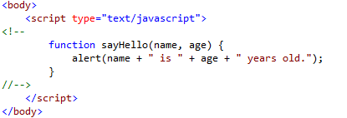
JavaScript Functions
Calling a Function
To invoke a function somewhere later in the script, you would simply need to write the name of that function

Slide 26
JavaScript Functions
The return Statement
This is required if you want to return a value from a function.
<script>
let x = myFunction(4, 3);
document.getElementById("demo").innerHTML = x;
function myFunction(a, b) {
return a * b;
}
</script>

Slide 27
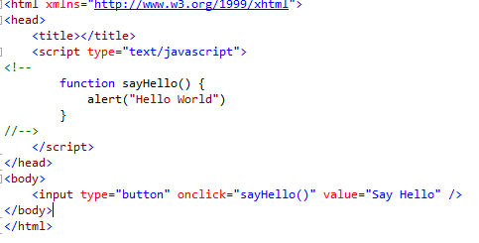
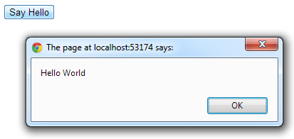
JavaScript Functions

Slide 28


JavaScript Basics
Variables & Constants
JavaScript Operators
Conditional Statements
JavaScript Events

Slide 29

Questions?

